Slide 1
Essential Systems
The Race to a New System
Louis Ries, Andrew Huff, Krysta Albertson, Nick Phelps, Jordan Gates, Adam Passanisi
Kentucky Horsemen’s Benevolent and Protective Association

Slide 2
Agenda
Problem
Case Diagram
Prototypes
Review
Use Case

Slide 3
Problem Statement
Can’t receive money for reports or donations online
No ability to process forms, claims, memberships, sales bills or reports online
Newsletter not electronically available online
No plan for business continuity
Mobile website needs to be modernized

Slide 4
Use Cases
Create Member
Log into Account
Make a Donation
Send Newsletter
Submit Forms
Process Claim
Recover Data
Backup Data

Slide 5
Create Member
Main Flow
The use case begins when the member selects “Register”.
While the customer details are invalid:
The system asks the member for the required details consisting of :
an e-mail address,
password, password confirmation,
stable name,
address,
phone number,
membership type
KRC license number.
The system ensures the member’s details are not left blank.
Alternate Flows
InvalidEmailAddress
InvalidPassword
Cancel
Preconditions
A member clicks on the register button on the KY HBPA homepage.
Postconditions
A member account is created for the member.
A member cancels the account creation process.

Slide 6
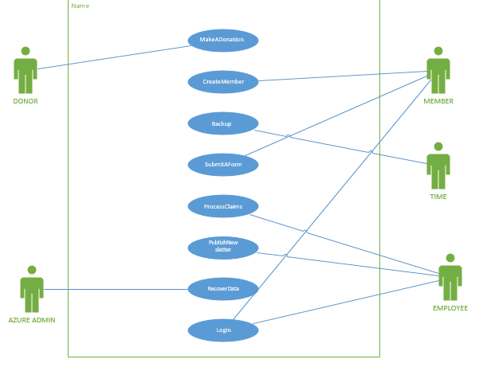
Use Case Diagram

Slide 7
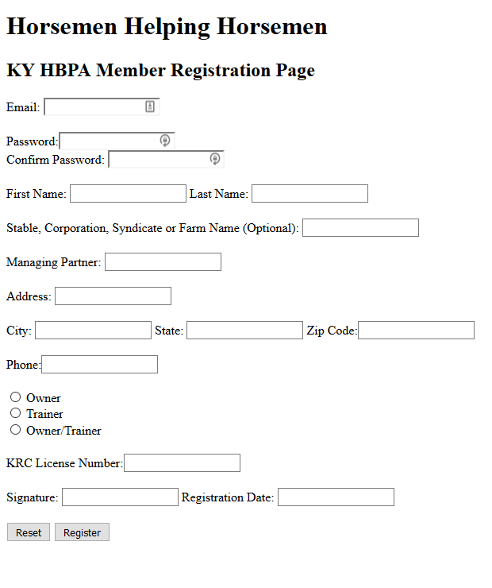
Create Member

Slide 8
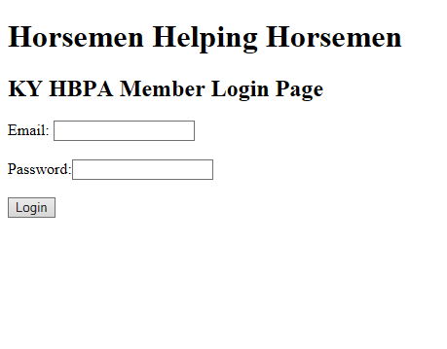
Log into Account

Slide 9
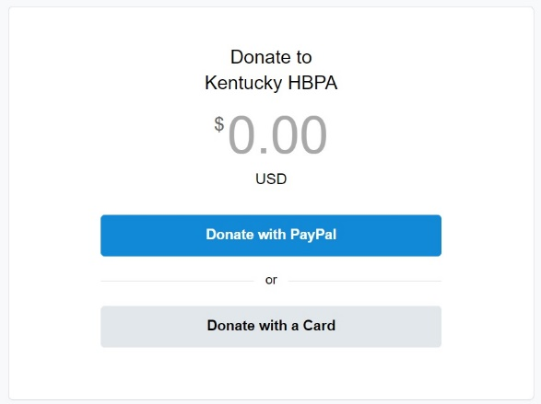
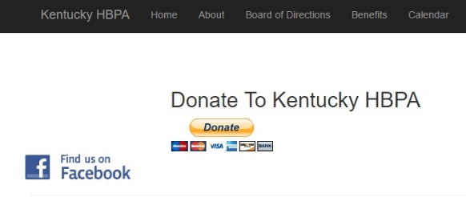
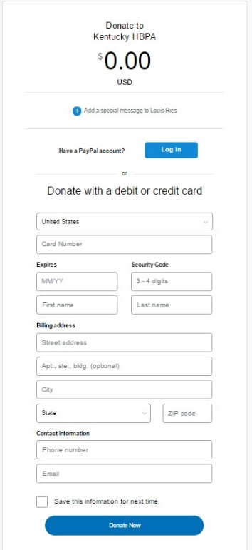
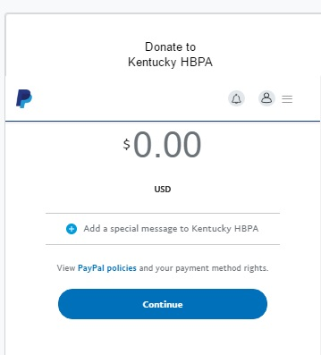
Make a Donation

Slide 10
Send Newsletter
Main Flow​
The use case begins after the employee signs into the G Suite account. ​
The employee then types out the email.
The employee then sends it to the master list from the database.
Alternate Flows​
Invalid Email Address​
Preconditions​
A subscription is needed to use G Suite.
An internet connection is needed to get to G Suite
Postconditions​
An email is sent to the members
​

Slide 11
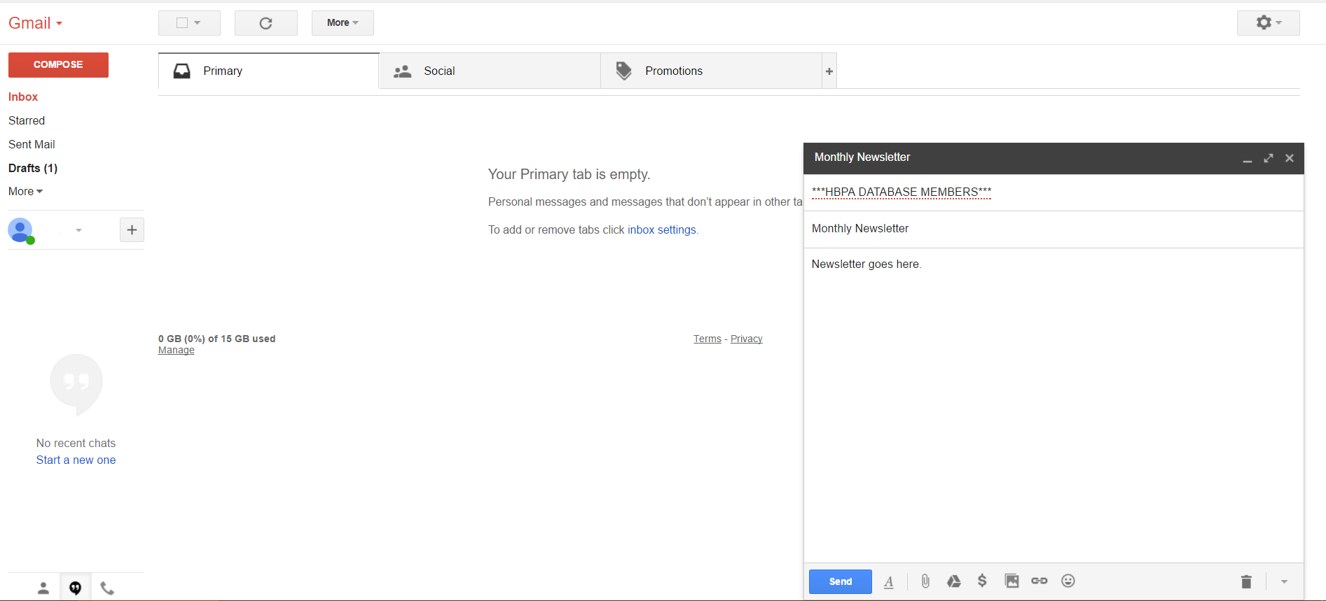
Send Newsletter

Slide 12
Submit Forms
Main Flow​
The use case begins when the member selects “Submit a Form” under the Forms tab. ​
The member then browses his or her computer.
The member then selects their scanned form or picture of their completed form.
Alternate Flows​
Invalid File Type
Cancel​
Preconditions​
A member selects the "Forms" tab on the website.
Postconditions​
A file is submitted for the member.​
A member cancels the file submission process. ​
​

Slide 13
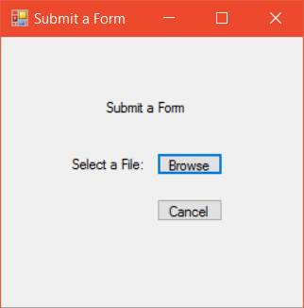
Submit Forms

Slide 14
Process Claims
Main Flow:
Member clicks on 'Process Claim' tab
Member fills in questions on the form
Member clicks 'Submit Claim' button.
The claim is sent to the KHBPA
Alternative Flows
Answer boxes are left empty
Invalid data is entered into an answer box
Preconditions
Must have an internet connection
Postconditions
The member's claim has been submitted for approval
The member will receive a message whether their claim has been approved or not

Slide 15
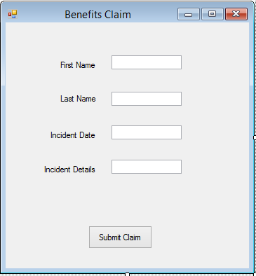
Process Claims

Slide 16
Backup Data
Main Flow
-Resource manager (a Microsoft Azure snap in application) is used
-Backups are scheduled
-Files chosen are backed up
Alternate Flow
-Backup us done manually
-Same thing, files are chosen to be backed up, but it happens immediately
Pre-Condition
-Must have access to Microsoft Azure
Post-Condition
-Files are backed up
-If something goes wrong and machines are corrupted or unable to open, they can be restored with a previous backup.

Slide 17
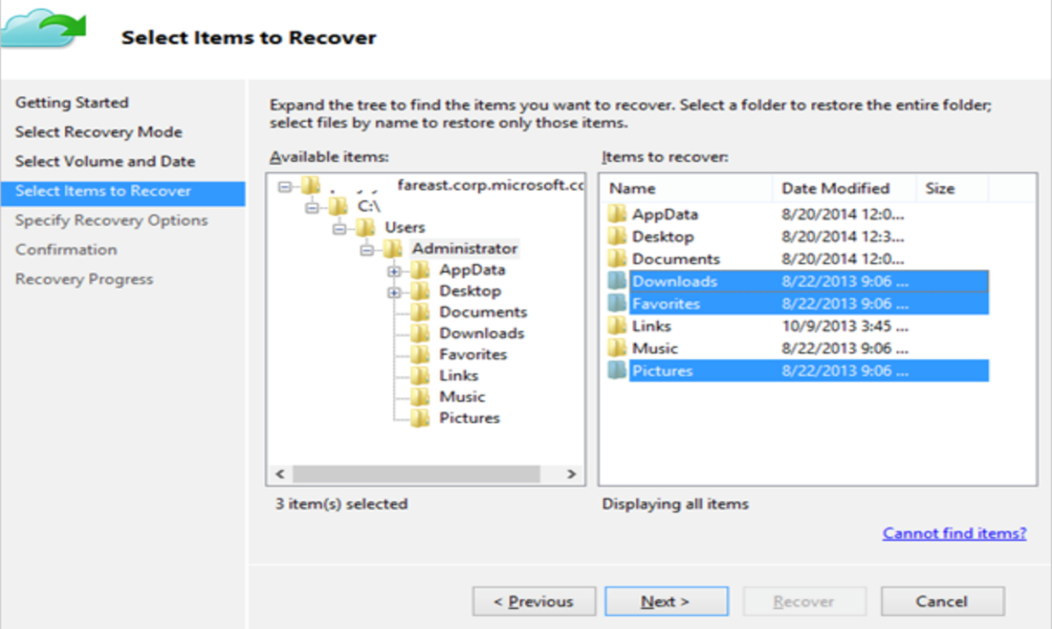

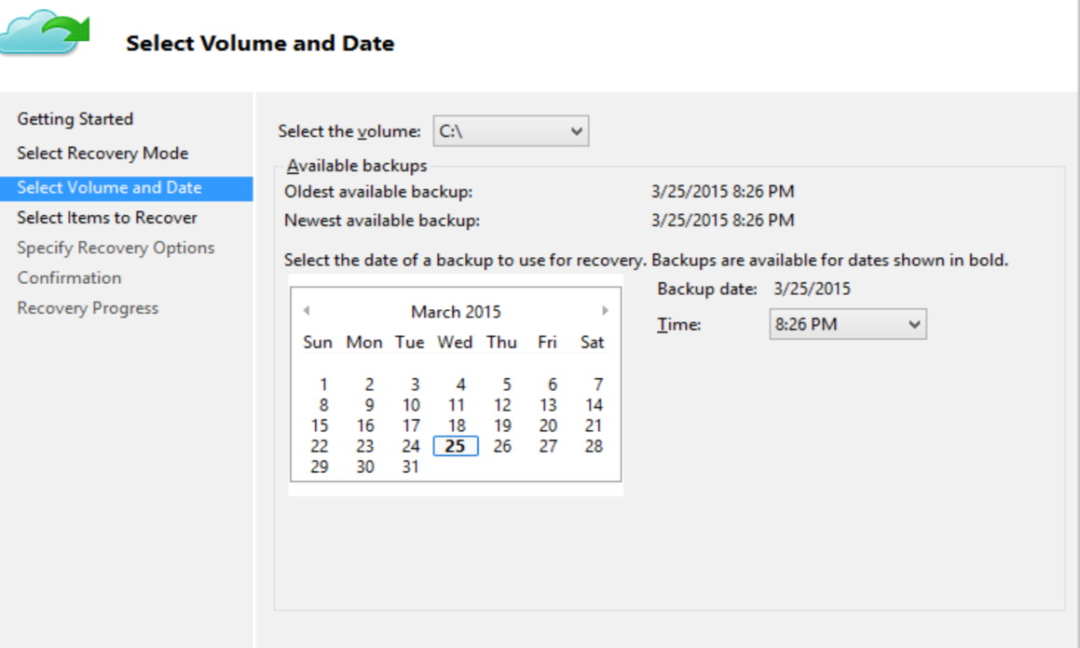
Backup Data

Slide 18
Recover Data
Main Flow –
-The actor uses the Resource Manager
-Choose recover
-Chose the server (the machine data is being recovered on)
-Browse for files
-Chose the recovery date
-Select items to recover
-Specify location
-Confirm
Alternate Flow-
-Recover the data on an alternate device
-Instant restore
-Cancel
Preconditions-
-The backup method must be implemented.
Post conditions-
-The files will be recovered.
-Check the data restored for any corruption or missing data.
-The data is not restored.

Slide 19
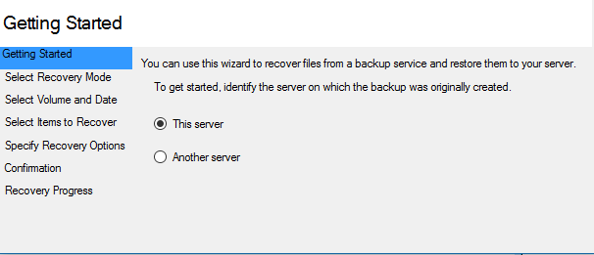
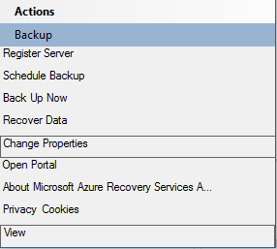
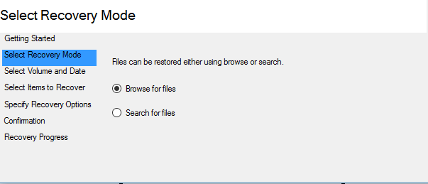
Recover Data

Slide 20
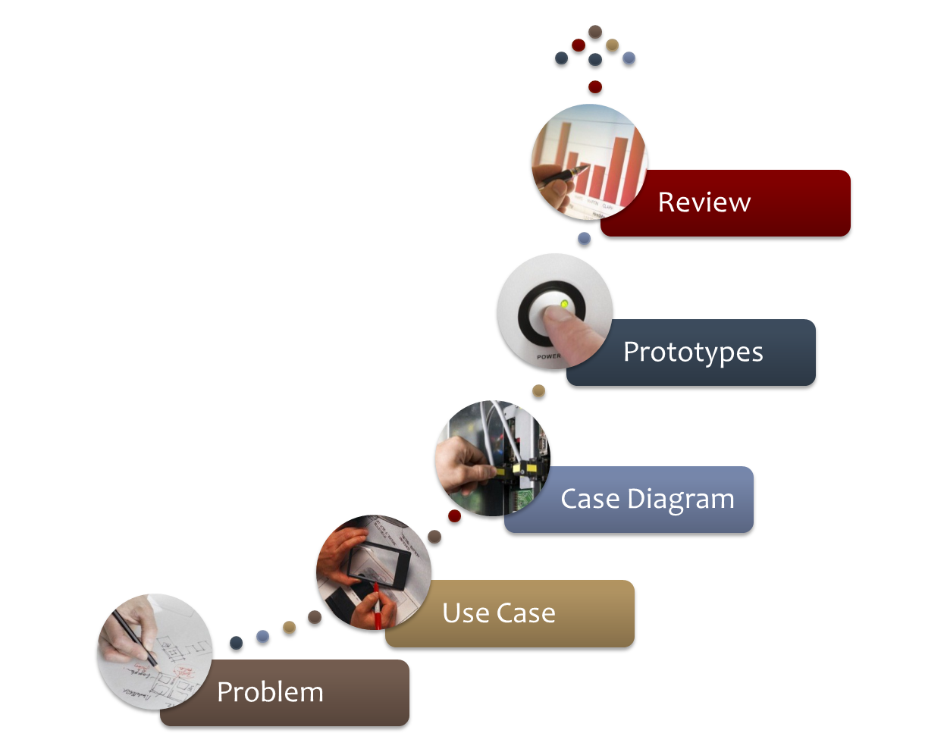
Review

Slide 21
Questions?

